Slide 1

Made By – Lakshya Singh(201901248)
Topic – Image Processing Edge Detection
Course – EL467 (Digital Programming)
Guided By – Prof. Yash Agrawal

Slide 2
INTRODUCTION
Edge detection is an image processing technique for finding the boundaries of the object within an image.
Edge detection is an image processing technique for finding the boundaries of the object within an image.
Edge detection is one of the most common preprocessing steps in image processing algorithms such as image enhancement , image segmentation, tracking and image/video coding ,it provokes great interest in the research fraternity.

Slide 3
EDGE DETECTION ALGORITHMS
There are many edge detection algorithms. I have focused to the following three algorithm-
1.Sobel Operator –
Sobel edge detection gives an averaging and smoothing effect over the image therefore it also takes care of the noise present in the image.
2. Canny’s Operator-
A Canny edge detector is a multi-step algorithm to detect the edges for any input image.
Steps are Smoothing , Finding gradients, Non-maximum suppression , Double thresholding , Edge tracking by hysteresis.

Slide 4
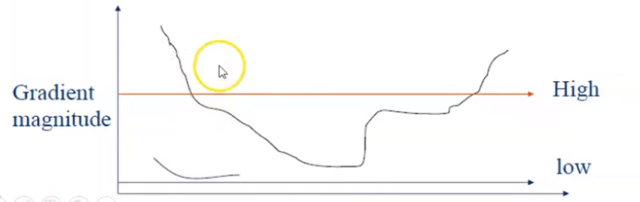
Hysteresis Thresholding

Slide 5


Sobel Operator
For applying edging we have used MATLAB and Xilinx System.
Result-
Input Image
Output Image

Slide 6
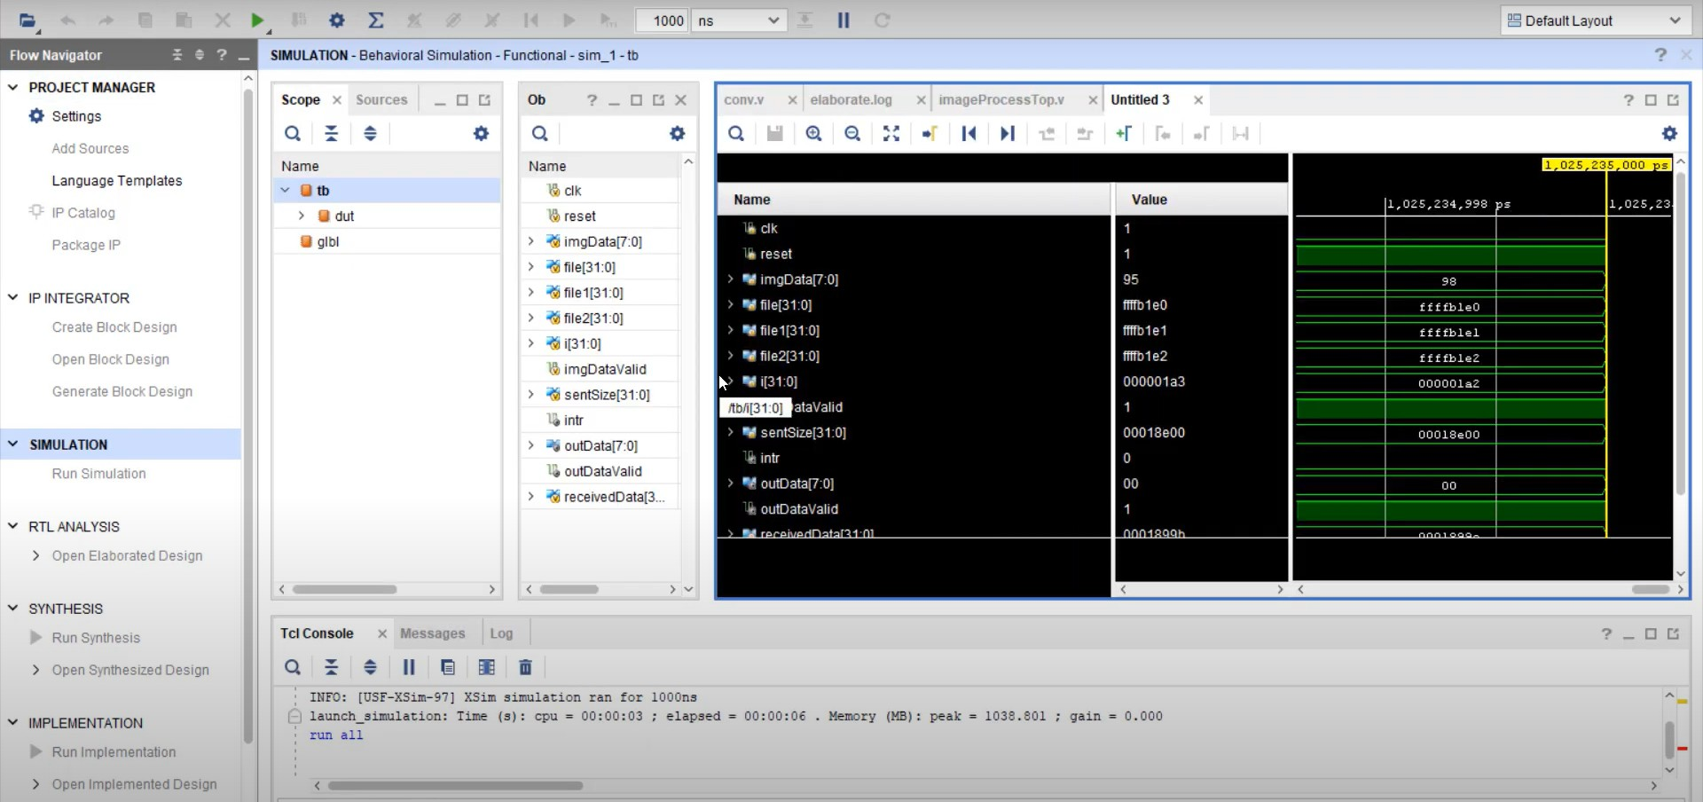
Graphical Representation(Sobel)

Slide 7




Canny’s Operator
Input Image
Horizontal Sobel
Vertical Sobel
Output Image

Slide 8
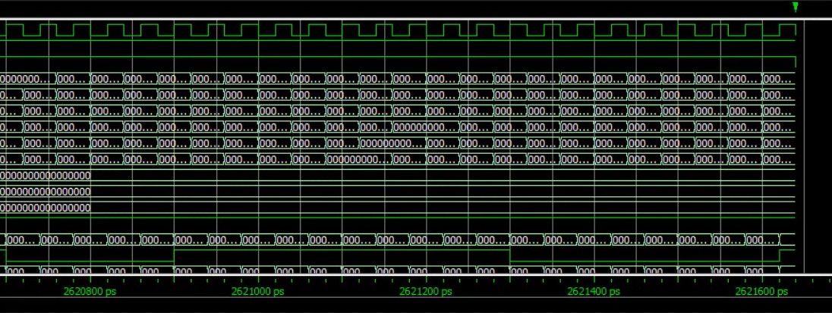
Graphical Representation(Canny’s)

Slide 9
THANK YOU

